Slide 1

Server Applications for CSV Sync & Web Security
Group Members:
- Abdul Haseeb
- Md Monirul Haque Arnob
- Azwad Abir
- Thevindu
Unit: COIT13240 Applied Cryptography
Date: 25-05-2026

Slide 2
Project Overview
#CSV Secure File Sync (Python, HTTP + crypto)
#Secure Web App (Apache HTTPS – secure vs insecure)
##Goal: Encrypt, Upload, Decrypt, Analyse, Capture packets
##Real internet hosts (cloud VMs), not just virtual machines

Slide 3
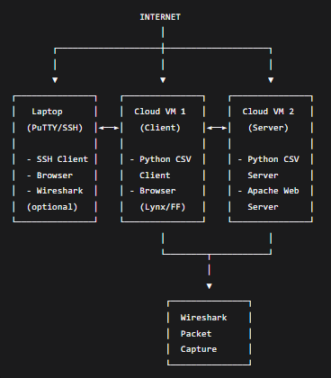
System Setup (Diagram)

Slide 4
CSV Secure File Sync – Design Choices
Protocol: HTTP + custom headers
Symmetric ciphers
Key exchange: Diffie-Hellman

Slide 5

CSV App – Commands & Workflow
Client CLI:
encrypt file.csv
decrypt file.csv.enc
upload file.csv.enc
Server CLI:
report (decrypts all received CSVs)

Slide 6
CSV App – Planned Crypto
Item Planned Choice
Cipher 1 AES-256-GCM
Cipher 2 ChaCha20-Poly1305
Key Exchange Diffie-Hellman
Integrity Built-in (GCM/Poly1305)

Slide 7
Web App – Planned Configs
Secure: TLS 1.3 only, strong ciphers, HSTS on
Insecure: TLS 1.0 + 1.1, weak ciphers (3DES/RC4), HSTS off

Slide 8
Web App Planned Tests
HTTPS connection Firefox / Lynx
Cipher check openssl s_client
Packet capture Wireshark
Vuln scan (optional) testssl.sh

Slide 9
Reflection
What you learned
Strength
Weakness
Future

Slide 10
Conclusion
What We're Building
CSV Secure File Sync
Secure Web App
Key Insight
Encryption alone is not enough.
Final Takeaway
"Security is a system, not a single cipher."

